Slide 1

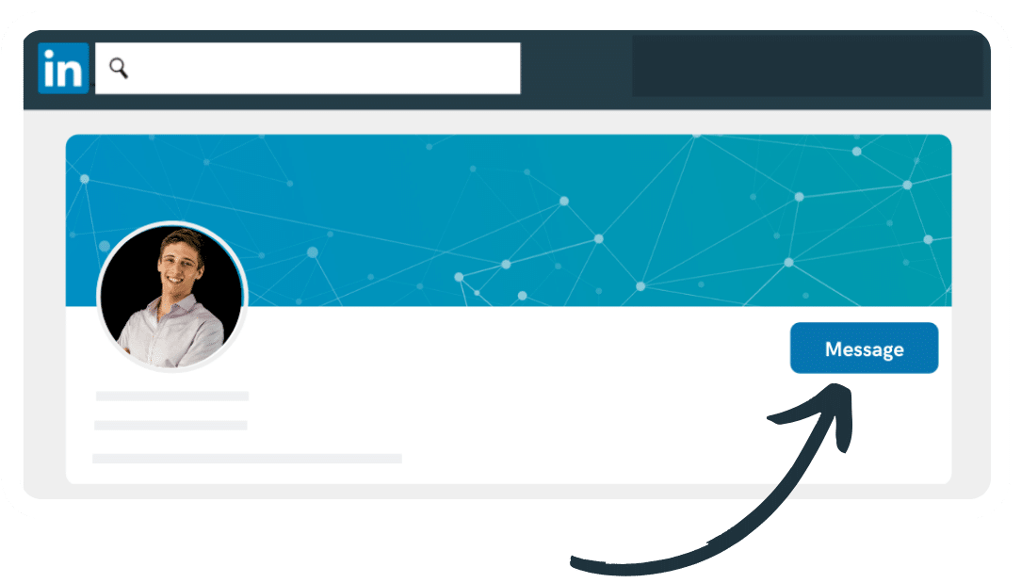
Problem statement: To Improve LinkedIn Messaging
Personas
Recruiters
Sales Professionals
Job Seeker
Influencers
What Does LinkedIn Messaging Do?
LinkedIn messaging allows the people to connect through sharing of messages to reach out to a particular person in a large professional community of linkedIn through one to one communication.
Out of these four personas I would like to focus on Job Seekers.
Goal
I have decided to increase engagement and retention by improving messaging feature which will automatically add to revenue.

Slide 2

Pain points of Job Seekers:
If a jobseeker opens his linkedIn account after a long time then it becomes very difficult for him to prioritize which message is important or which needs to be ignored.
It is not possible for jobseeker to identify the notifications on gmail via linkedin messaging whether it is a in mail or a direct message.
There is no track of information about for a particular job profile a candidate has sent message to which company and which recruiter.

Slide 3
Solutions:
Feature to mark the message as important while sending it so that when in future one get reply on the same message so it highlights or appear in upper section which reduces the risk to skip the important message.
Gmail notifications which users receive must have proper subject mentioning whether it is a in mail message or a direct message.
User can apply filter on messages on the basis of company, job profile, recruiter, etc. which helps him to keep track of his messages that he has sent for a specific job profile, to whom and when.

Slide 4
Summary:
Providing the important messages first will save the time of user in searching it through a list of messages and notifications on gmail with subject mentioning their category will improve the user experience on linkedIn messaging tool.

